Slide 1
Intro to Infrastructure as Code
Introduction to Chef
All Things Open – October 2014

Slide 2
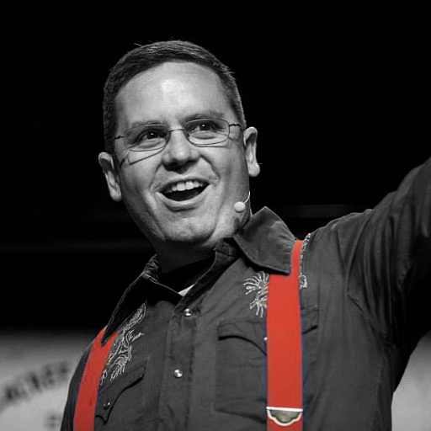

Nathen Harvey
Community Director at Chef
Co-host of the Food Fight Show
Co-organizer of DevOpsDC meetup
Occasional farmer – http://bit.ly/farmer-nathen
@nathenharvey
nharvey@getchef.com

Slide 3

Let’s do it live!
https://www.google.com/+/learnmore/hangouts/

Slide 4
Kick off the demo

Slide 5
Hello!
System Administrator?

Slide 6
Hello!
System Administrator?
Developer?

Slide 7
Hello!
System Administrator?
Developer?
Ruby developer?

Slide 8
Hello!
System Administrator?
Developer?
Ruby developer?
DevOp?

Slide 9
Hello!
System Administrator?
Developer?
Ruby developer?
DevOp?
Business Person?

Slide 10
Are you experienced?
Experience with Infrastructure as Code or Configuration Management?

Slide 11
Are you experienced?
Experience with Infrastructure as Code or Configuration Management?
Experience with Chef?

Slide 12
Which version control system do your use?

Slide 13
Which version control system do your use?
cp foo foo.bak

Slide 14
Which version control system do your use?
cp foo foo.bak
cp foo{,.`date +%Y%m%d%H%M`}

Slide 15
Which version control system do your use?
cp foo foo.bak
cp foo{,.`date +%Y%m%d%H%M`}
cp foo{,.`date +%Y%m%d%H%M`-`$USER`}

Slide 16
Infrastructure as Code

Slide 17
The Sys Admin’s Journey
ssh

Slide 18
The Sys Admin’s Journey
ssh
Store notes in ~/server.txt

Slide 19
The Sys Admin’s Journey
ssh
Store notes in ~/server.txt
Move notes to the wiki

Slide 20
The Sys Admin’s Journey
ssh
Store notes in ~/server.txt
Move notes to the wiki
Write some scripts (setup.sh, fixit.sh, etc.)

Slide 21
The Sys Admin’s Journey
ssh
Store notes in ~/server.txt
Move notes to the wiki
Write some scripts (setup.sh, fixit.sh, etc.)
Golden images and snapshots

Slide 22
The Sys Admin’s Journey
ssh
Store notes in ~/server.txt
Move notes to the wiki
Write some scripts (setup.sh, fixit.sh, etc.)
Golden images and snapshots
Policy-driven configuration management

Slide 23
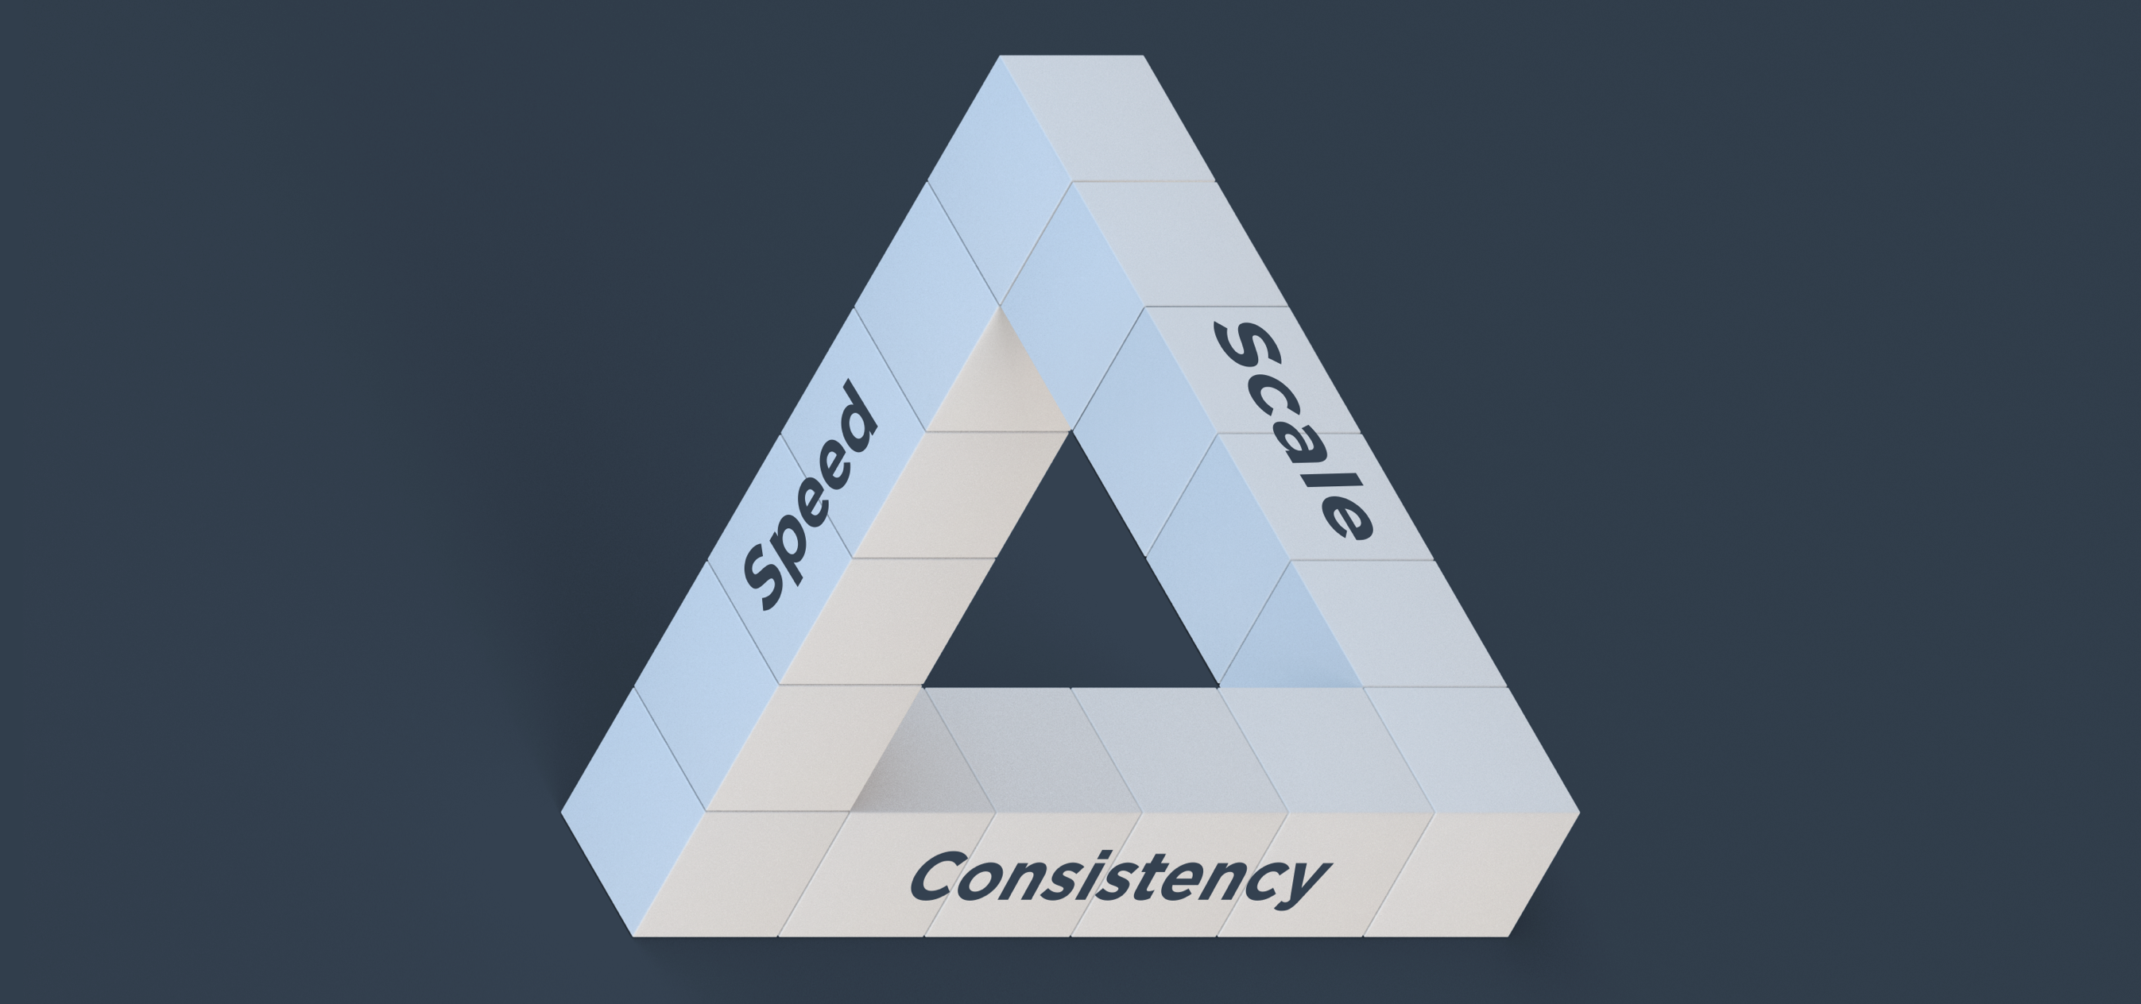
Benefits of Automation

Slide 24
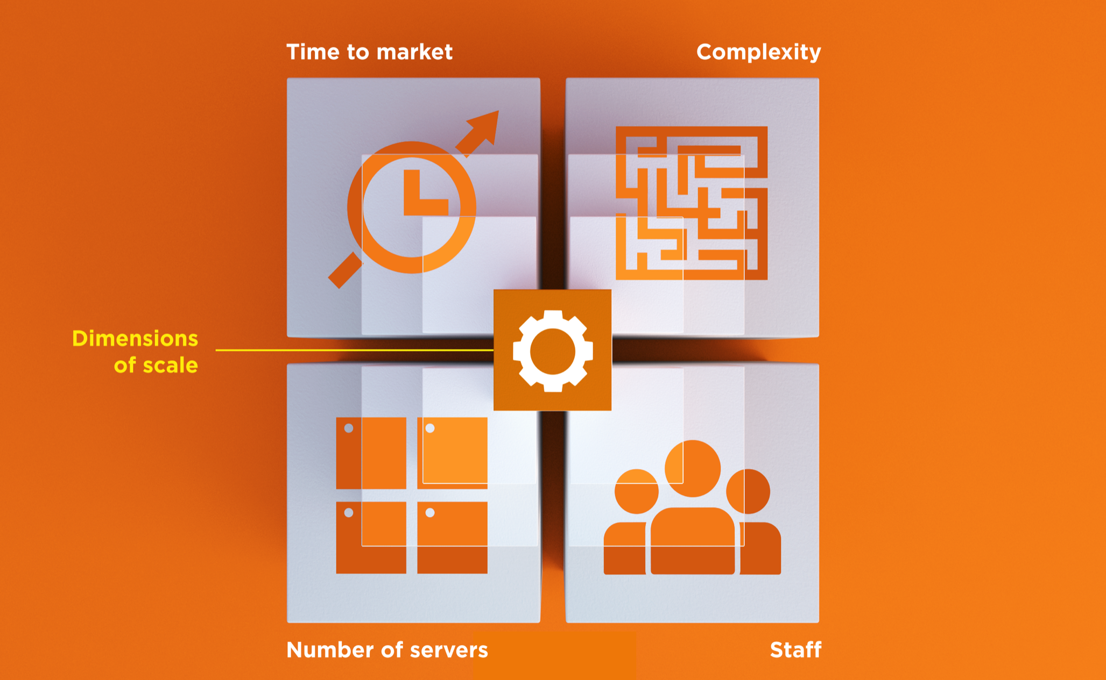
Dimensions of Scale

Slide 25
Automation Platform
Creates a dependable view of your entire network’s state.
Can handle complex dependencies among the nodes of your network.
Is fault tolerant.
Is secure.
Can handle multiple platforms
Can manage cloud resources
Provides a foundation for innovation

Slide 26
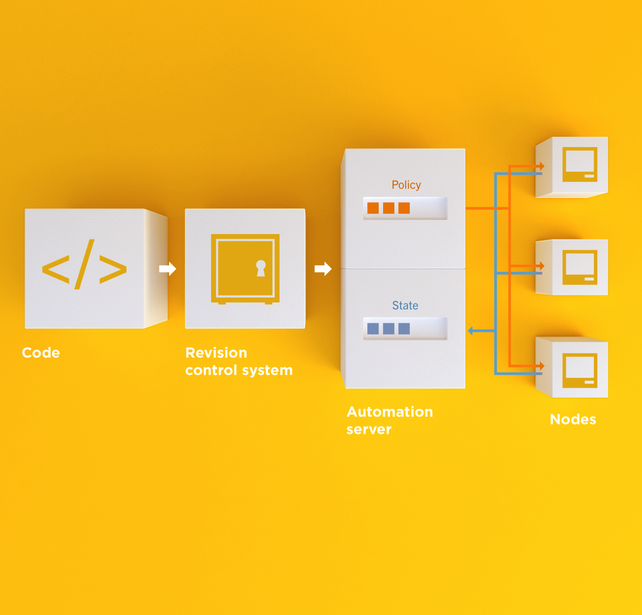
Infrastructure as Code
Programmatically provision and configure components
Notes:
Use the Chef framework and Chef programming language to define the components of your infrastructure. This allows you to capture and document the shape of your infrastructure in a consistent way.

Slide 27
Infrastructure as Code
Treat like any other code base
Notes:
Treat this like any other code base:
Store the code in a version control system.
Add automated tests to the code.
Refactor the code over time.
Build and version software artifacts (e.g. packages)
The code is executable documentation.
Store the code in a version control system.

Slide 28
Infrastructure as Code
Reconstruct business from code repository, data backup, and compute resources
Notes:
With your infrastructure now fully captured in code, you are now able to rebuild your entire business, well, at least all of your business’s applications, with your code repository, a backup of your data, and compute resources, be they bare metal, virtual machines, or cloud instances.

Slide 29
Infrastructure as Code
Programmatically provision and configure components
Treat like any other code base
Reconstruct business from code repository, data backup, and compute resources
Notes:
Stop for a minute and think about what we're saying here. Think about how freeing this can be. The next configuration change you need to make in production starts with a commit to your version control system. You can re-provision your infrastructure with another service provider; move from the data center to the clould and back again.How will this impact the way you run operations in your organization?What questions do you have?

Slide 30
Policy-based
You capture the policy for your infrastructure in code
A program ensures each node in your infrastructure complies with the policy
A control loop keeps the system stable and allows for change when policy is updated

Slide 31
Sample Infrastructure
Graphite
Nagios
JBoss
Memcache
Postgres Slaves
Postgres Master

Slide 32
New Compliance Mandate!
Graphite
Nagios
JBoss
Memcache
Postgres Slaves
Postgres Master

Slide 33
New Compliance Mandate!
Graphite
Nagios
JBoss
Move SSH off of port 22
Let’s put it on 2022
Memcache
Postgres Slaves
Postgres Master

Slide 34
6 Golden Images to Update
Graphite
1
1
Nagios
1
1
1
1
1
JBoss
1
1
Memcache
1
1
Postgres Slaves
1
Postgres Master

Slide 35
6 Golden Images to Update
Graphite
1
2
Nagios
3
JBoss
/etc/ssh/sshd_config
--- a/sshd_config
+++ b/sshd_config
-Port 22
+Port 2202
4
Memcache
5
Postgres Slaves
6
Postgres Master

Slide 36
12 Instances to replace
Graphite
1
2
Nagios
3
4
5
6
7
JBoss
Launch
Delete
Repeat
Typically manually
8
9
Memcache
10
11
Postgres Slaves
12
Postgres Master

Slide 37
Done in maintenance window
Graphite
1
2
Nagios
3
4
5
6
7
JBoss
High stakes
Late hours
Risky change
8
9
Memcache
10
11
Postgres Slaves
12
Postgres Master

Slide 38
New configurations required?
Graphite
Nagios
JBoss
Do the new instances have new IP Addresses?
* Not all connections shown
Memcache
Postgres Slaves
Postgres Master

Slide 39
Golden Images vs. Policy-based

Slide 40
Chef
Fast, scalable, flexible IT automation

Slide 41
What is Chef
Open source framework for managing complexity in your infrastructure through policy-driven automation code
A community of professionals
A company
Notes:
~60K professionals

Slide 42
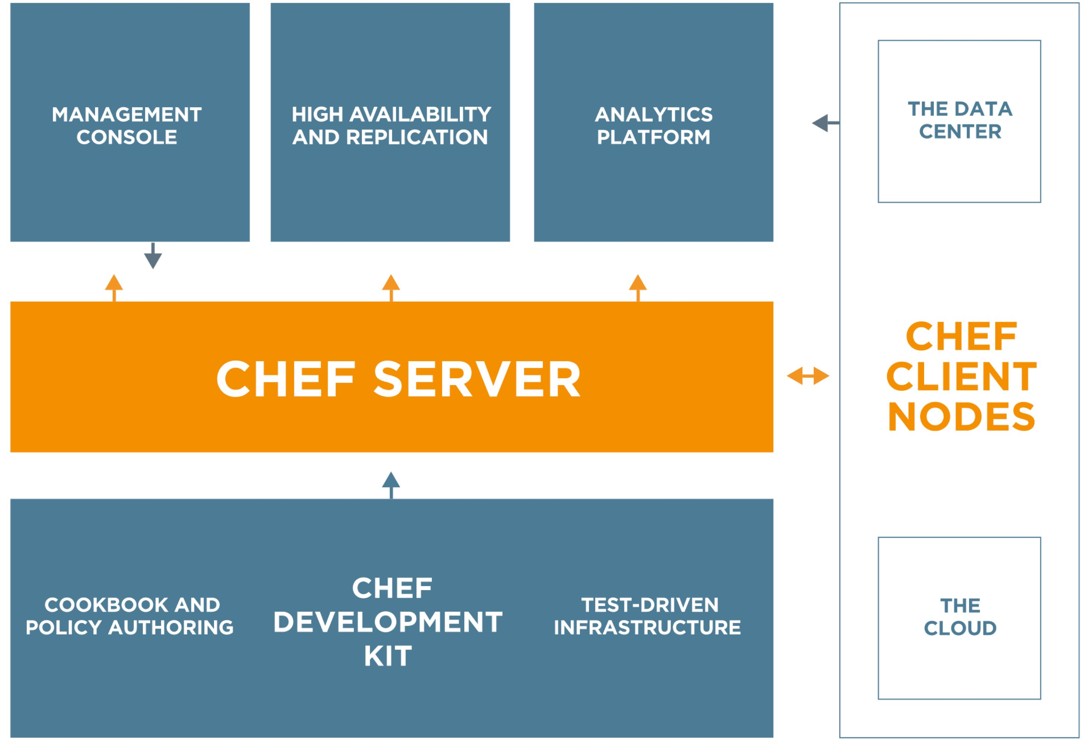
Chef
https://www.getchef.com/chef/
Notes:
All Open Source!

Slide 43
Chef Server – Policy & State
Notes:
Policy –

Slide 44
Desired Configuration

Slide 45
Desired Configuration

Slide 46
Desired Configuration

Slide 47
Chef Server – Policy & State
Notes:
Policy –

Slide 48
HA Proxy Configuration

Slide 49
HA Proxy Configuration

Slide 50
HA Proxy Configuration

Slide 51
HA Proxy Configuration

Slide 52
HA Proxy Configuration

Slide 53
HA Proxy Configuration

Slide 54
HA Proxy Configuration

Slide 55
HA Proxy Configuration

Slide 56
HA Proxy Configuration

Slide 57
Building your policy
Resources and Recipes
Notes:
Policy is defined as a collection of resources in recipes. There are lots of abstractions on top of this but resources are the basic building blocks.

Slide 58
Resources
Piece of the system and its desired state
Package that should be installed
Service that should be running
File that should be generated
Cron job that should be configured
User that should be managed
And more
docs.getchef.com/chef/resources.html

Slide 59
Hello, Chef!
~/hello_chef.rb
file "/tmp/hello_chef.txt" do
content "Hello, Chef"
mode "0777"
end

Slide 60
Apply the policy
sudo chef-apply hello_chef.rb
Recipe: (chef-apply cookbook)::(chef-apply recipe)
* file[/tmp/hello_chef.txt] action create
- create new file /tmp/hello_chef.txt
- update content in file /tmp/hello_chef.txt from none to 79c290
--- /tmp/hello_chef.txt 2014-10-22 19:59:04.000000000 -0400
+++ /tmp/.hello_chef.txt20141022-23075-19aelx1 2014-10-22 19:59:04.000000000 -0400
@@ -1 +1,2 @@
+Hello, Chef
- change mode from '' to '0777'

Slide 61
Resources
Describe the desired state
Do not need to tell Chef how to get there
What happens when you re-apply the policy?

Slide 62
Apply the policy
sudo chef-apply hello_chef.rb
Recipe: (chef-apply cookbook)::(chef-apply recipe)
* file[/tmp/hello_chef.txt] action create (up to date)

Slide 63
Resources
A piece of the system
Its desired state
file "/tmp/hello_chef.txt" do
content "Hello, Chef"
mode "0777"
end

Slide 64
Change the state of the system
echo “Hello, #ato2014” > /tmp/hello_chef.txt

Slide 65
Apply the policy
sudo chef-apply hello_chef.rb
Recipe: (chef-apply cookbook)::(chef-apply recipe)
* file[/tmp/hello_chef.txt] action create
- update content in file /tmp/hello_chef.txt from e453df to 79c290
--- /tmp/hello_chef.txt 2014-10-22 20:00:20.000000000 -0400
+++ /tmp/.hello_chef.txt20141022-23340-17a7m5t 2014-10-22 20:00:50.000000000 -0400
@@ -1,2 +1,2 @@
-“Hello, #ato2014”
+Hello, Chef

Slide 66
Resources – Test and Repair
Resources use a test and repair model
Resource currently in the desired state?
Yes – Do nothing
No – Bring the resource into the desired state (repair)

Slide 67
Built-in Resources
package
template
service
cron
directory
mount
user
group
registry_key
remote_directory
route
and many more…
docs.getchef.com/chef/resources.html

Slide 68
Recipes
Policy is defined as a collection of resources in recipes. There are lots of abstractions on top of this but resources are the basic building blocks.

